Slide 1

Real Estate Pricing Analysis in Germany

Slide 2
Germany- A Demanding REAL ESTATE MARKET
One of the most biggest and economically strong country in Europe
Rapid population increase annually (more than 1.000.000)
Sustainable economic and industrial development
Large interest in real estate market especially in the last decade, due to the rapid increase of population

Slide 3
DATA
Dataset utilized from kaggle.com (Germany Real Estate Housing Price)
Germany – Housing Price in April 2020
Average housing price in different german states (Bundesländer)
Dataset includes: Population, Postal Code, Current house situation, Date of construction, Number of rooms

Slide 4
METHODOLOGY
Clustering Machine Learning Problem
K-Means method
Elbow Method to specify the best number for clusters
Foursquare data platform – acquiring venue information

Slide 5
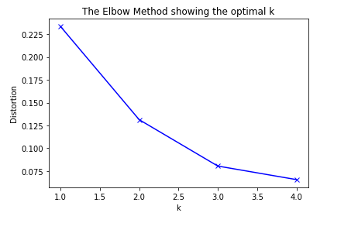
RESULTS
Elbow Method
Most sufficient number of clusters : 3

Slide 6
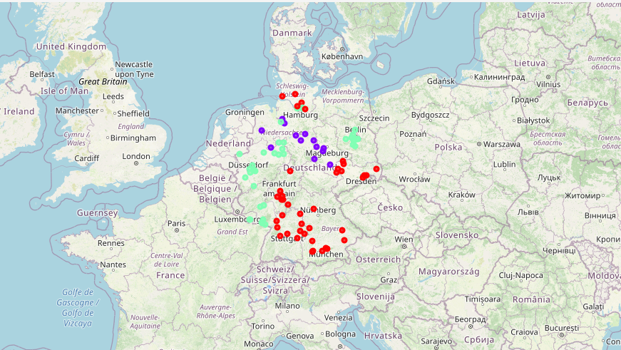
Interactive map
Map of Germany – Illustrates the clusters in different german states

Slide 7
Binning
We created bins in order to create price intervals and categorize them as follows:
“Low Price” (price < 1.000.000 €)
“Medium Price” (1.000.000 € < price < 3.000.000 €)
“High Price” ( price > 3.000.000 € )
Surprisingly, according to our results the biggest percentage of the housing prices around Germany belongs to the “Low Price” category , a small percentage to “Medium Price” and an extremely small one to “High Price”.
Additionally, the most common venues are quite the same in every german state with non remarkable differences. Although as it was expected quantity of each venue differs from state to state .

Slide 8
conclusion
Housing price in Germany is still in an affordable level even in a demanding state such as Berlin in which the german capital is located, taking into account the average financial situation in Germany. Undoubtedly, the level of prices depends on the location in each state ( See Bayern – appears the highest price ) and the kind of venues around the area ( Bayern-Hotels and Restaurants- Highest Price ).

